Slide 1
Unit V
Data Link Control
(PART I)
Vinit R Tribhuvan
vrt22.comp@coep.ac.in
1
Notes:
Data Communication

Slide 2
Data Link Layer
Communication at the data-link layer is node-to-node.
A data unit from one point in the Internet needs to pass through many networks (LANs and WANs) to reach another point. Theses LANs and WANs are connected by routers.
The data-link layer is located between the physical and the network layers.
The datalink layer provides services to the network layer;
It receives services from the physical layer.
the data-link layer of a node (host or router) is responsible for delivering a datagram to the next node in the path.
first service provided by the data-link layer is framing. It encapsulates the datagram in a frame before sending it to a frame.
A packet at the data-link layer is normally called a frame.
2
Notes:
Data Communication

Slide 3
Data Link Layer
Flow control - If the rate of produced frames is higher than the rate of consumed frames, frames at the receiving end need to be buffered while waiting to be consumed (processed).
Error control - error detection and correction is an issue in every layer. The error needs first to be detected. After detection, it needs to be either corrected at the receiver node or discarded and retransmitted by the sending node.
3
Notes:
Data Communication

Slide 4
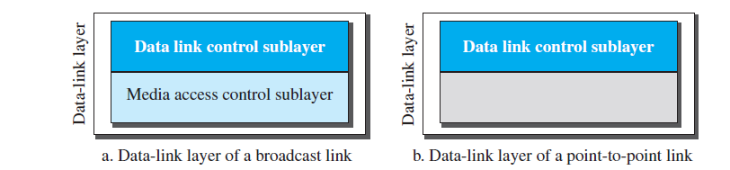
We study the data-link layer into two sublayers: data link control (DLC) and media access control (MAC).
The data link control sublayer deals with all issues common to both point-to-point and broadcast links;

Slide 5
Data Link Control (DLC)

Slide 6
DLC Services
Framing
Flow Control
Error Control
Connectionless and Connection Oriented

Slide 7
Framing
Pack bits into frames.
For instance, postal system practices a type of framing.
Framing in the data-link layer separates a message from one source to a destination by adding a sender address and a destination address.
destination address defines where the packet is to go; sender address helps the recipient acknowledge the receipt.
Frame size acts like a delimiter.
The size of a fixed size frame acts like a delimiter.

Slide 8
Variable sized framing
Two approaches :
character-oriented approach
bit-oriented approach.

Slide 9
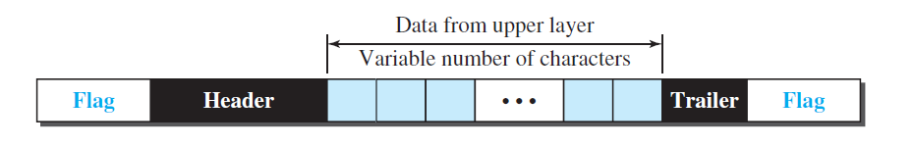
Character oriented approach
Character-oriented (or byte-oriented) framing
Data is usually 8 bit character (ASCII)
Header – source and destination address
Trailer - carries error detection redundant bits
To separate frames, 8-bit (1-byte) flag is added at the beginning and the end of a frame.
The flag, composed of protocol-dependent special characters, signals the start and end of the frame.

Slide 10
Problem?
any character used for the flag could also be part of the information.
the receiver, when it encounters this pattern in the middle of the data, thinks it has reached the end of the frame.

Slide 11
Byte Stuffing
Special byte is added to data section of a frame, when there is a character with the same pattern as the flag.
Data section is stuffed with an extra byte – escape character (ESC).
Whenever the receiver encounters the ESC character, it removes it from the data section and treats the next character as data.

Slide 12
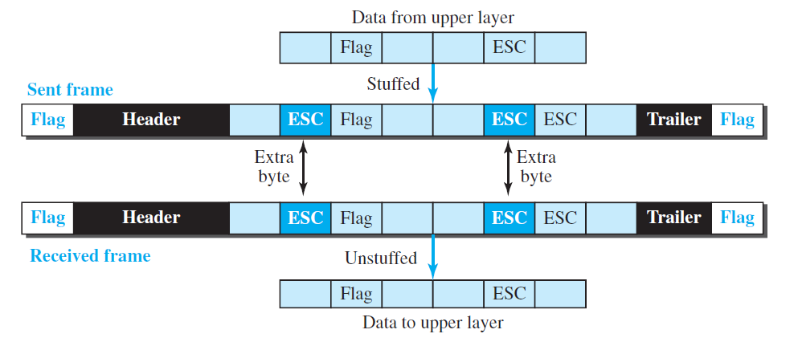

Slide 13
Byte stuffing is the process of adding one extra byte whenever there is a flag or escape character in the text.
What happens if the text contains one or more escape characters followed by a byte with the same pattern as the flag?
Solution - Receiver removes the escape character, but keeps the next byte, which is incorrectly interpreted as the end of the frame.
To solve this problem, the escape characters that are part of the text must also be marked by another escape character.
If the escape character is part of the text, an extra one is added to show that the second one is part of the text.

Slide 14
Another problem – We deal with Unicode, have 16-bit and 32-bit characters that conflict with 8-bit characters.

Slide 15
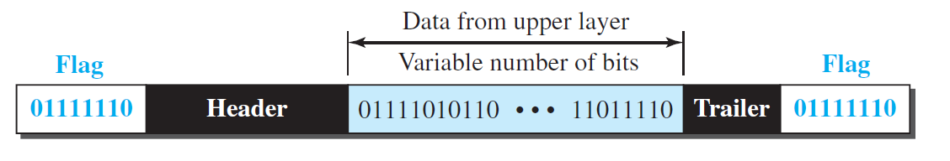
Bit oriented Framing
the data section of a frame is a sequence of bits to be interpreted by the upper layer as text, graphic, audio, video.
in addition to headers (and possible trailers), we still need a delimiter to separate one frame from the other.
use a special 8-bit pattern flag, 01111110, as the delimiter

Slide 16
Bit stuffing
Can create the same problem as in character-oriented protocol
If flag-pattern appears in the data, it has to be informed that it is not the end.
Solution – stuff one extra bit to prevent the pattern look like a flag.

Slide 17
In bit stuffing, if a 0 and five consecutive 1 bits are encountered, an extra 0 is added.
extra stuffed bit is eventually removed from the data by the receiver.
the extra bit is added after one 0 followed by five 1s regardless of the value of the next bit.

Slide 18
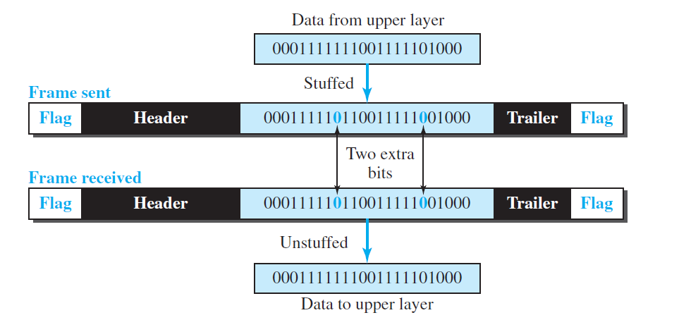
Bit stuffing and unstuffing
if the flaglike pattern 01111110 appears in the data, it will change to 011111010 (stuffed) and is not mistaken for a flag by the receiver.

Slide 19
Flow control
A basic producer – consumer problem
There must be a balance.
If the items are produced faster than they can be consumed, the consumer can be overwhelmed and may need to discard some items.
Flow control is required to prevent loss of data at receiver site.

Slide 20
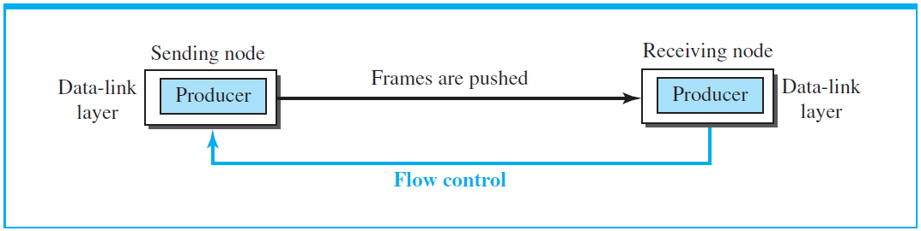
concentrate on the relationship between two data-link layers, as shown in Figure

Slide 21
the data-link layer at the sending node tries to push frames toward the data-link layer at the receiving node.
If the receiving node cannot process and deliver the packet to its network at the same rate that the frames arrive, it becomes overwhelmed with frames.
Flow control in this case can be feedback from the receiving node to the sending node to stop or slow down pushing frames.

Slide 22
Buffering
one of the solutions is normally to use two buffers; one at the sending data-link layer and the other at the receiving data-link layer.
A buffer is a set of memory locations that can hold packets at the sender and receiver.
The flow control communication can occur by sending signals from the consumer to the producer.
When the buffer of the receiving data-link layer is full, it informs the sending data-link layer to stop pushing frames.

Slide 23
Error control
There is a need to implement error control at the data-link layer to prevent the receiving node from delivering corrupted packets to its network layer.
Method 1 - if the frame is corrupted, it is silently discarded; if it is not corrupted, the packet is delivered to the network layer. This method is used mostly in wired LANs such as Ethernet.
Method 2 - if the frame is corrupted, it is silently discarded; if it is not corrupted, an acknowledgment is sent (for the purpose of both flow and error control) to the sender.

Slide 24
Flow and error control can be combined. In a simple situation, the acknowledgment that is sent for flow control can also be used for error control to tell the sender the packet has arrived uncorrupted.
A frame that carries an acknowledgment is normally called an ACK to distinguish it from the data frame.

Slide 25
A DLC protocol can be either connectionless or connection-oriented

Slide 26
Connectionless
In a connectionless protocol, frames are sent from one node to the next without any relationship between the frames; each frame is independent.
Note that the term connectionless here does not mean that there is no physical connection (transmission medium) between the nodes; it means that there is no connection between frames.
The frames are not numbered and there is no sense of ordering.
Most of the data-link protocols for LANs are connectionless protocols

Slide 27
Connection oriented
a logical connection should first be established between the two nodes (setup phase). After all frames that are somehow related to each other are transmitted (transfer phase), the logical connection is terminated (teardown phase).
the frames are numbered and sent in order. If they are not received in order, the receiver needs to wait until all frames belonging to the same set are received and then deliver them in order to the network layer.
Connection oriented protocols are used in in some point-to-point protocols, some wireless LANs, and some WANs.

Slide 28
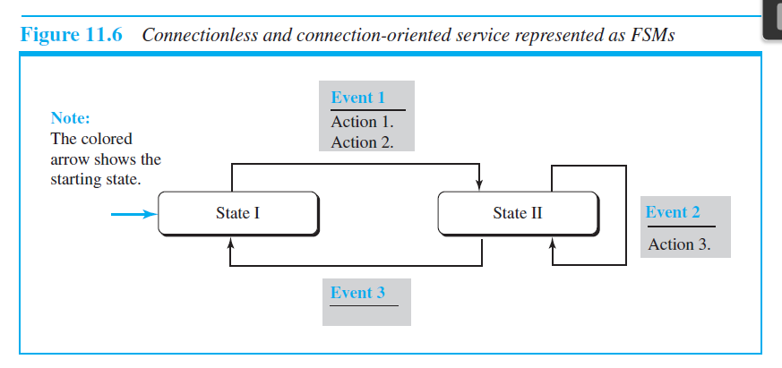
Protocols
The behavior of a data-link-layer protocol can be better shown as a finite state machine (FSM).

Slide 29
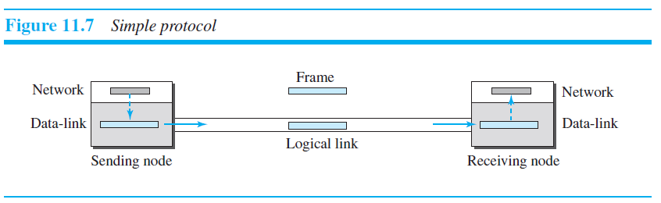
Simple protocol
simple protocol with neither flow nor error control.
the receiver can immediately handle any frame it receives.

Slide 30
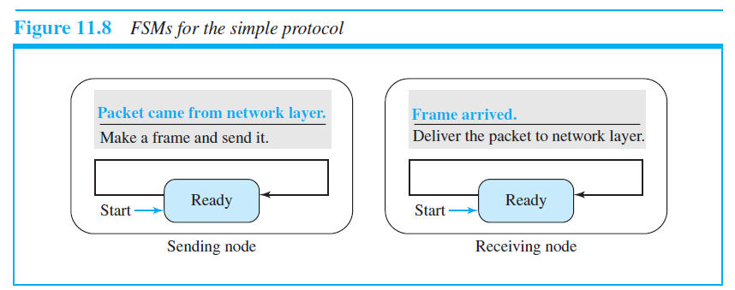
FSM for simple protocol

Slide 31
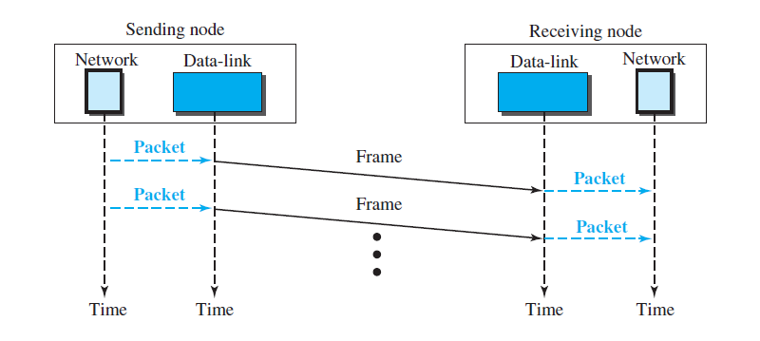
Flow diagram for simple protocol

Slide 32
Stop and Wait protocol
Sender sends a frame at a time
Sender stops and waits for acknowledgement before sending next one
CRC is used to detect corrupted frames
If its CRC is incorrect, the frame is corrupted and silently discarded
The silence (no response) from receiver is a signal that packet was discarded or lost.

Slide 33
Stop and Wait protocol
Sender starts a timer every time it sends a frame.
If acknowledgment is received from reciver, timer is stopped and next frame is sent.
If the timer expires, the sender resends the previous frame.
Sender keeps a copy of frame until acknowledgement arrives.
It discards the copy when acknowledgement is received.

Slide 34
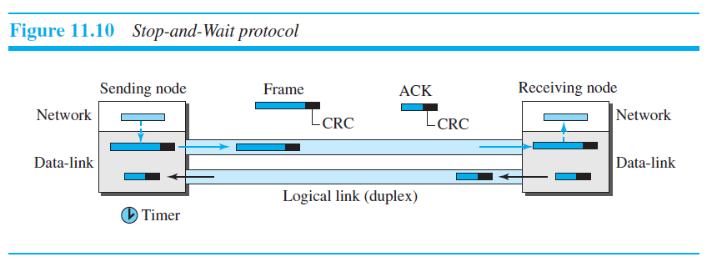
Stop and Wait protocol

Slide 35
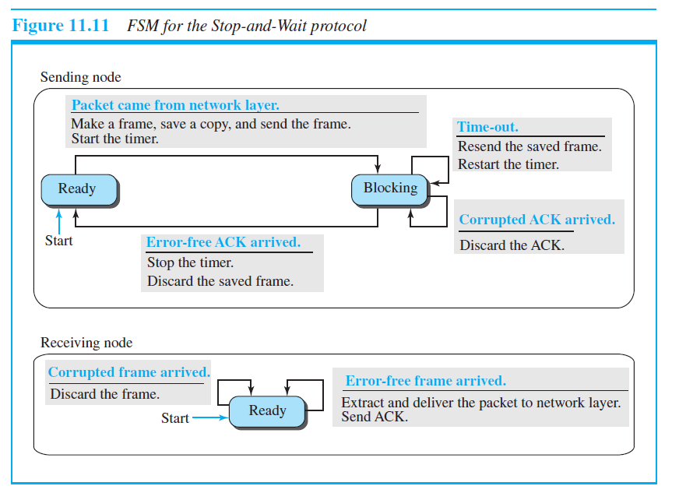
FSM for stop and wait protocol

Slide 36
Sender states
Ready state
When the sender is in this state, it is only waiting for a packet from the network layer.
If a packet comes from the network layer, the sender creates a frame, saves a copy of the frame, starts the only timer and sends the frame.
The sender then moves to the blocking state.
Blocked State
If a time-out occurs, the sender resends the saved copy of the frame and restarts the timer.
If a corrupted ACK arrives, it is discarded.
If an error-free ACK arrives, the sender stops the timer and discards the saved copy of the frame. It then moves to the ready state.

Slide 37
Receiver state
The receiver is always in the ready state. Two events may occur:
If an error-free frame arrives, the message in the frame is delivered to the network layer and an ACK is sent.
If a corrupted frame arrives, the frame is discarded.

Slide 38
